Slide 1


Challenge Yourself: Maximizing
the Student Experience

Slide 2
Who do you compete with for students?

Slide 3
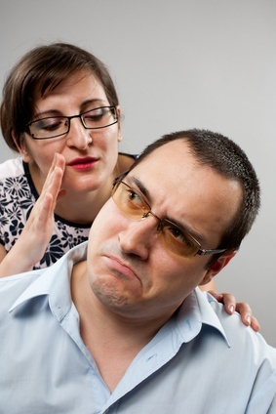
Notes:
Wife walks into the living room where her husband is reading. PAUSE
She leans over and says “I love you.” Nothing. She says louder. I love you.” PAUSE
Just like right now, complete silence. She says “YOU KNOW. I SAY I love you a LOT to you. You NEVER say I love you BACK. WHY IS THAT? Husband turns to her and says, “Look. I told you I loved you when we got married, if that should change, I’ll let you know.” Now is that enough? Of course not. If you want love TO FLOURISH you have to be reminded every so often.
FORWARD

Slide 4
People need
to be reminded
more often than
they need to be
instructed.
Samuel Johnson

Slide 5
The following presentation is a program to
“Challenge Yourself”.
The information expressed are that of the presenter and may not represent the views or opinions of MCCSSA.

Slide 6
One expectation of any meeting:
We want the meeting
to change things.

Slide 7
We make positive change in our life only when we get uncomfortable with who we are.

Slide 8
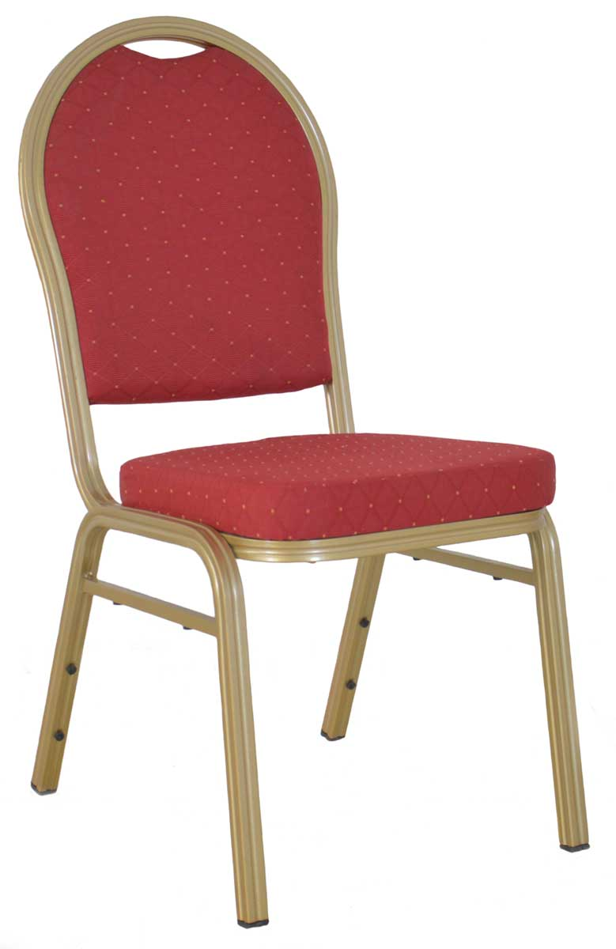

Slide 9
We make positive change in our life only when we get uncomfortable with who we are.

Slide 10
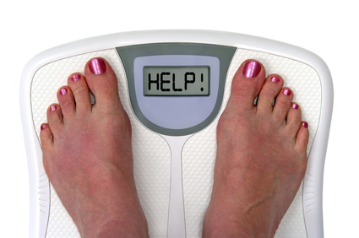
Notes:
It’s. . . By the way, those aren’t my feet. I’m not into pedicures that much . . . It’s when I go to the doctor for my check-up and I SAY TO HIM, Doc, before you tell me anything, I know I’m a little overweight. And he tells me, Bill, you’re not a little overweight, you ARE FAT. And if you don’t do something about it, you will die an early death. That’s when I get uncomfortable and make a change. TODAY I want to drive a belief that your team CAN deliver the World’s Best experience for your groups but in that process I am going to make you . . .
FORWARD

Slide 11
We make positive change in our life only when we get uncomfortable with who we are.

Slide 12
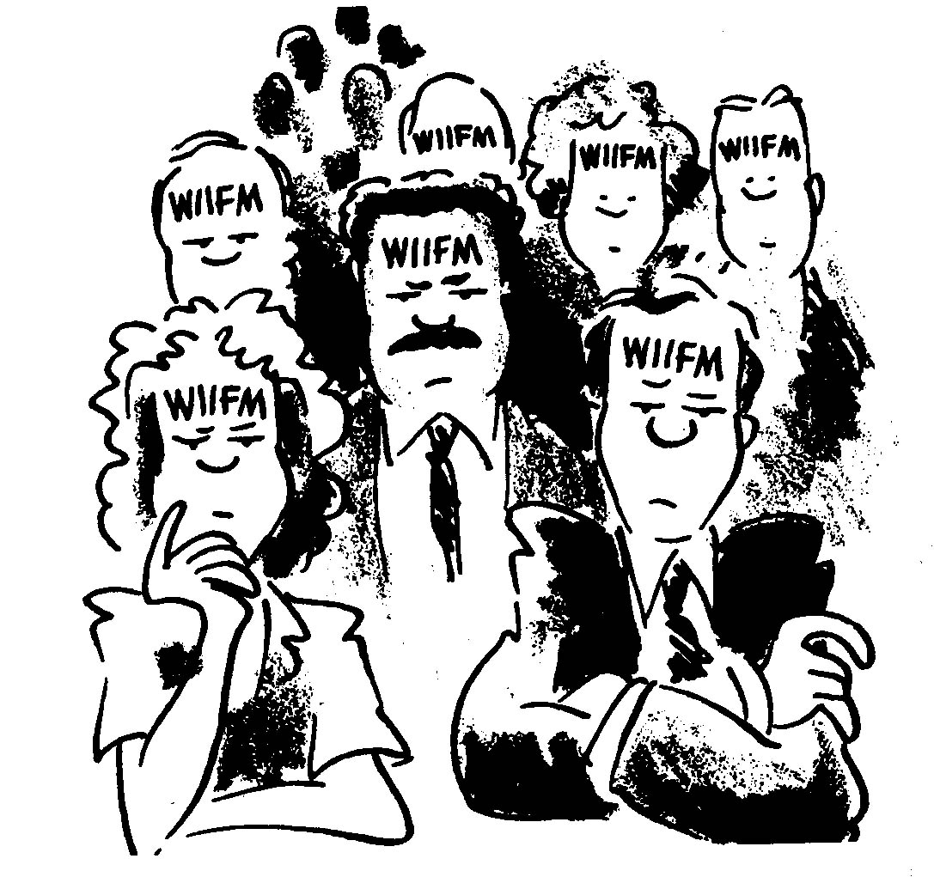

Slide 13
WIIFM
What’s in it for me?

Slide 14
Protects your job
Raises your profile
Job satisfaction

Slide 15
Why Now?

Slide 16
Your Mission
Prepare students to be successful

Slide 17
Any job is
20% knowledge and 80% interpersonal skills.
Dr. Stephen Covey
The Seven Habits of Highly Effective People

Slide 18
People can only deliver the level of service that they themselves have experienced.

Slide 19
People Skills
Bank tellers
Full service stations
Youth sports and activities
Phone calls and letters
Neighbors
ATM’s
Self service stations
Playstation and Facebook
Email and text messages
Strangers

Slide 20
So who is going to prepare the students to be successful?

Slide 21
Any job is
20% knowledge and 80% interpersonal skills.
Dr. Stephen Covey
The Seven Habits of Highly Effective People

Slide 22


Slide 23
What skills should a customer service professional have to be successful?

Slide 24
Do you have the skills to be successful?

Slide 25
Do you have the atttitude to be successful?

Slide 26
Mediocrity stems more from a lack of belief than a lack of ability.
Your commitment.

Slide 27


Slide 28


Commitment
Contribution

Slide 29
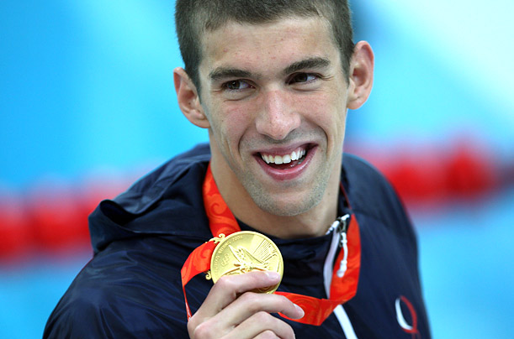
Notes:
Here is a superstar. Michael Phelps. I think we’d all agree that he is the World’s Best, not only World’s Best swimmer, but World’s Best Olympian having won eight gold medals at the Beijing Olympics. Let me tell you what he does to be the World’s Best.
FORWARD

Slide 30
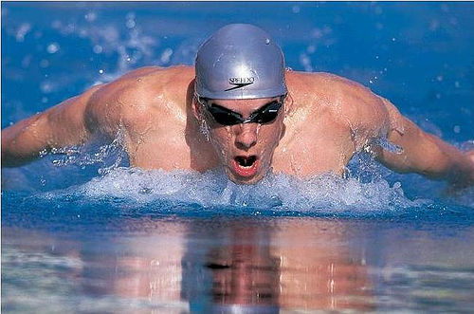
Notes:
Every day he is in a pool. 365 days a year. His birthday, every holiday, even New Year’s Day. He is in a pool two times a day. Before a meet, he is a pool four times a day. In just one week, IN ORDER TO BE THE WORLD’S BEST, he swims 40-50, not laps, but miles, per week. Would you consider that COMMITMENT?
Then, let me make you feel a little uncomfortable. What did YOU do last week to live up to your company’s belief that you could be The World’s Best FOR THEM? . . .
FORWARD

Slide 31
How committed
are you?

Slide 32
You don't get paid for the hour.
You get paid for the value you bring to the hour.
Jim Rohn

Slide 33
Challenge Yourself: Maximizing
the Student Experience

Slide 34
The Reason
Number One Matters
Restaurant Choices
Candidates selection
Student future

Slide 35
The Reason
Number One Matters
Restaurant Choices
Candidates selection
Your college

Slide 36
Is your
Community
College
ready?

Slide 37
Toothpaste

Slide 38
Grocery Store Chains

Slide 39
Laundry Detergent

Slide 40
Is your
Community
College
ready?

Slide 41
Who do you compete with for students?

Slide 42









Slide 43
Best

Slide 44
Best
in the
World
Notes:
44

Slide 45
Today’s Objective
Create
“Best in the World”
Student Experience

Slide 46
People either want the best or the least experience

Slide 47
People either want the best or the least experience

Slide 48
Best
in the
World
Notes:
48

Slide 49


Slide 50


Slide 51
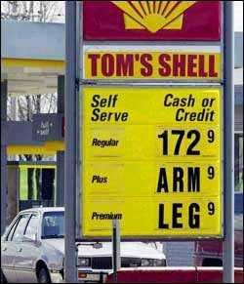

Slide 52
Price per gallon
Michigan $4.50
Alaska $6.34
Japan $7.11
United Kingdom $8.06
Notes:
PEOPLE DON’T BUY FROM COMPANIES. PEOPLE STILL BUY FROM People they know, People they like, People they trust and People who want their business AND
FORWARD

Slide 53
So how
do you do it?

Slide 54
Best
in the
World
Notes:
54

Slide 55
Best
in the
World
Notes:
55

Slide 56
CASE Method
Copy
And
Steal
Everything

Slide 57
CASE Method
Copy
And
Save
Everything

Slide 58
Our Mission
To attract
and retain
customers

Slide 59
Your Mission
To attract
and retain
students

Slide 60
So how do you do it?
How do you become Best in the World?
Student
as Customer

Slide 61
So how do you do it?
How do you become Best in the World?
The Three Principles
of Creating Customer Loyalty

Slide 62
Why Three?

Slide 63
Nobody remembers Number 4

Slide 64
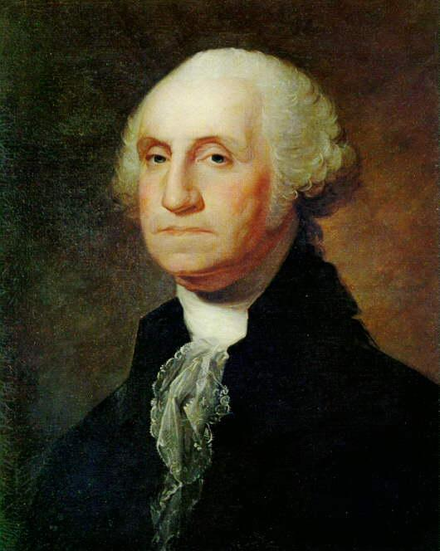
Notes:
Everyone knows George Washington. Who was #4?
FORWARD

Slide 65
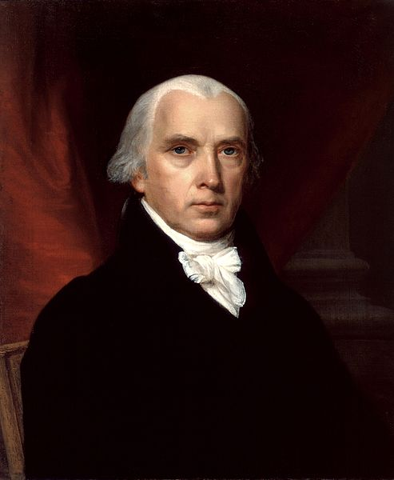
Notes:
James Madison. Who was the first person on the moon. Pause
FORWARD

Slide 66
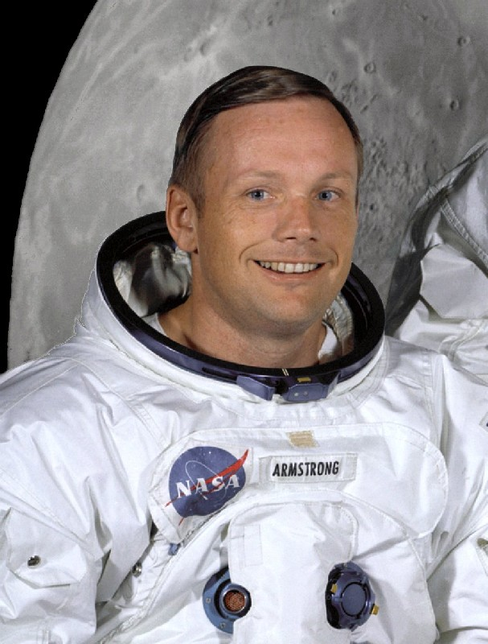
Notes:
Everyone knows Neil Armstrong. Who was #4? I’ll even show you his picture.
FORWARD

Slide 67
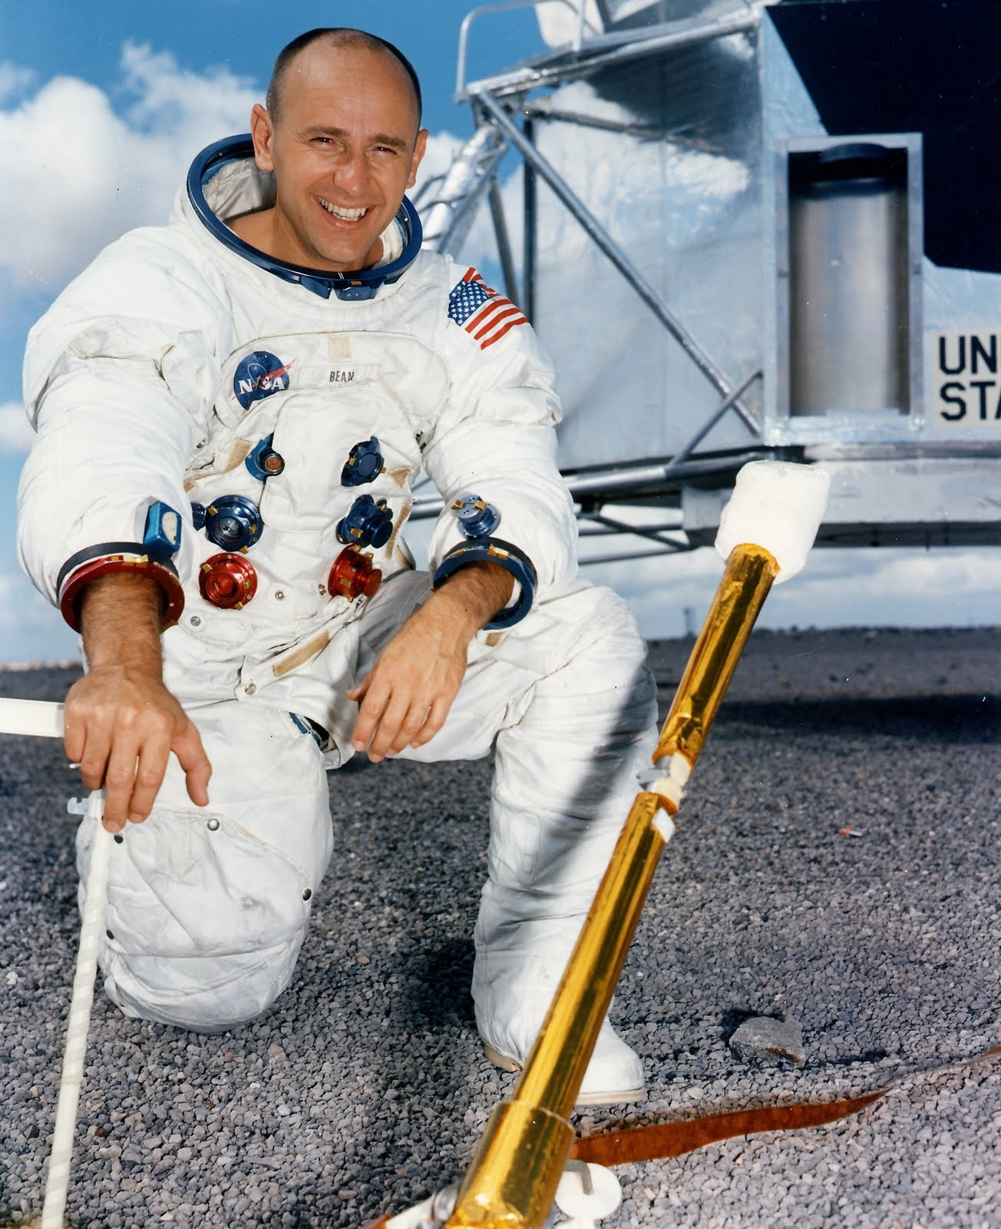
Notes:
Anybody recognize Alan Bean. No one remembers #4. So if you’re not #1, you don’t command market share and you may not even get mentioned when someone is thinking about your product or service. Now some of you may have said to yourself, “Oh I’ve heard of Alan Bean before.” But is that the kind of reputation you want, where someone has to jog a customer’s memory to get your company to be mentioned? Or do you want to be #1 where everyone is talking about you?
FORWARD

Slide 68
Why Loyalty?

Slide 69
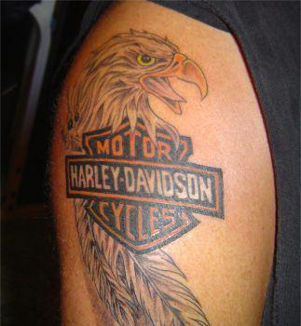

Slide 70
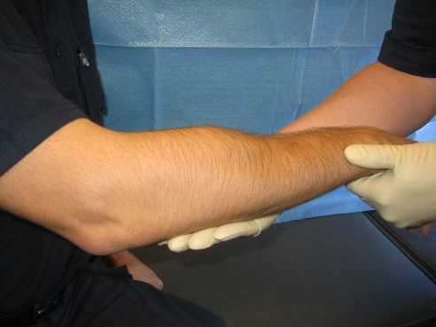
Your Community College
logo here

Slide 71
So how do you do it?
How do you become Best in the World?
The Three Principles
of Creating Student Loyalty

Slide 72
Principle One
Be Your Customer
Principle Two
Create Their Experience
Principle Three
Be the Difference

Slide 73
Principle One
Be Your Customer

Slide 74
Image is Everything.
Feelings are facts.
Perception is reality.

Slide 75
County Fair
Notes:
When I say County Fair what do you REMEMBER and FEEL about that experience.
If I said what do the grounds look like at the County Fair, what is your PERCEPTION?
You can see the HALF EATEN corn cobs and the cotton candy sticks on the grounds. What if I said COUNTY FAIR restrooms?
FORWARD

Slide 76
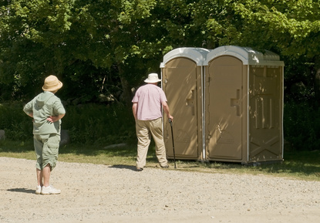
Notes:
You’re probably remember someone saying BEFORE you left home, “Go now, because you don’t want to go when you are at the fair.” You DON’T want to see what’s behind door #2.
What about if I said, County FAIR Ride operator. What is your perception. Probably something like this .
FORWARD

Slide 77
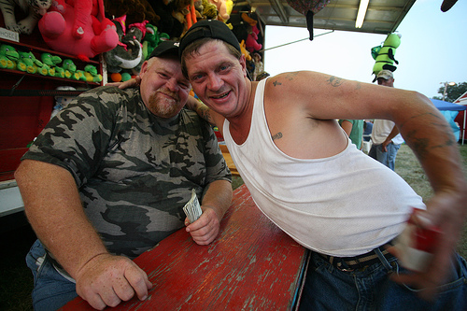
Notes:
(Count one second then . . .)
FORWARD

Slide 78
County Fair
Disney
Notes:
CLICK FOR EFFECT
Now I say to you Disney and I say the same three things. What do the grounds look like?
FORWARD

Slide 79
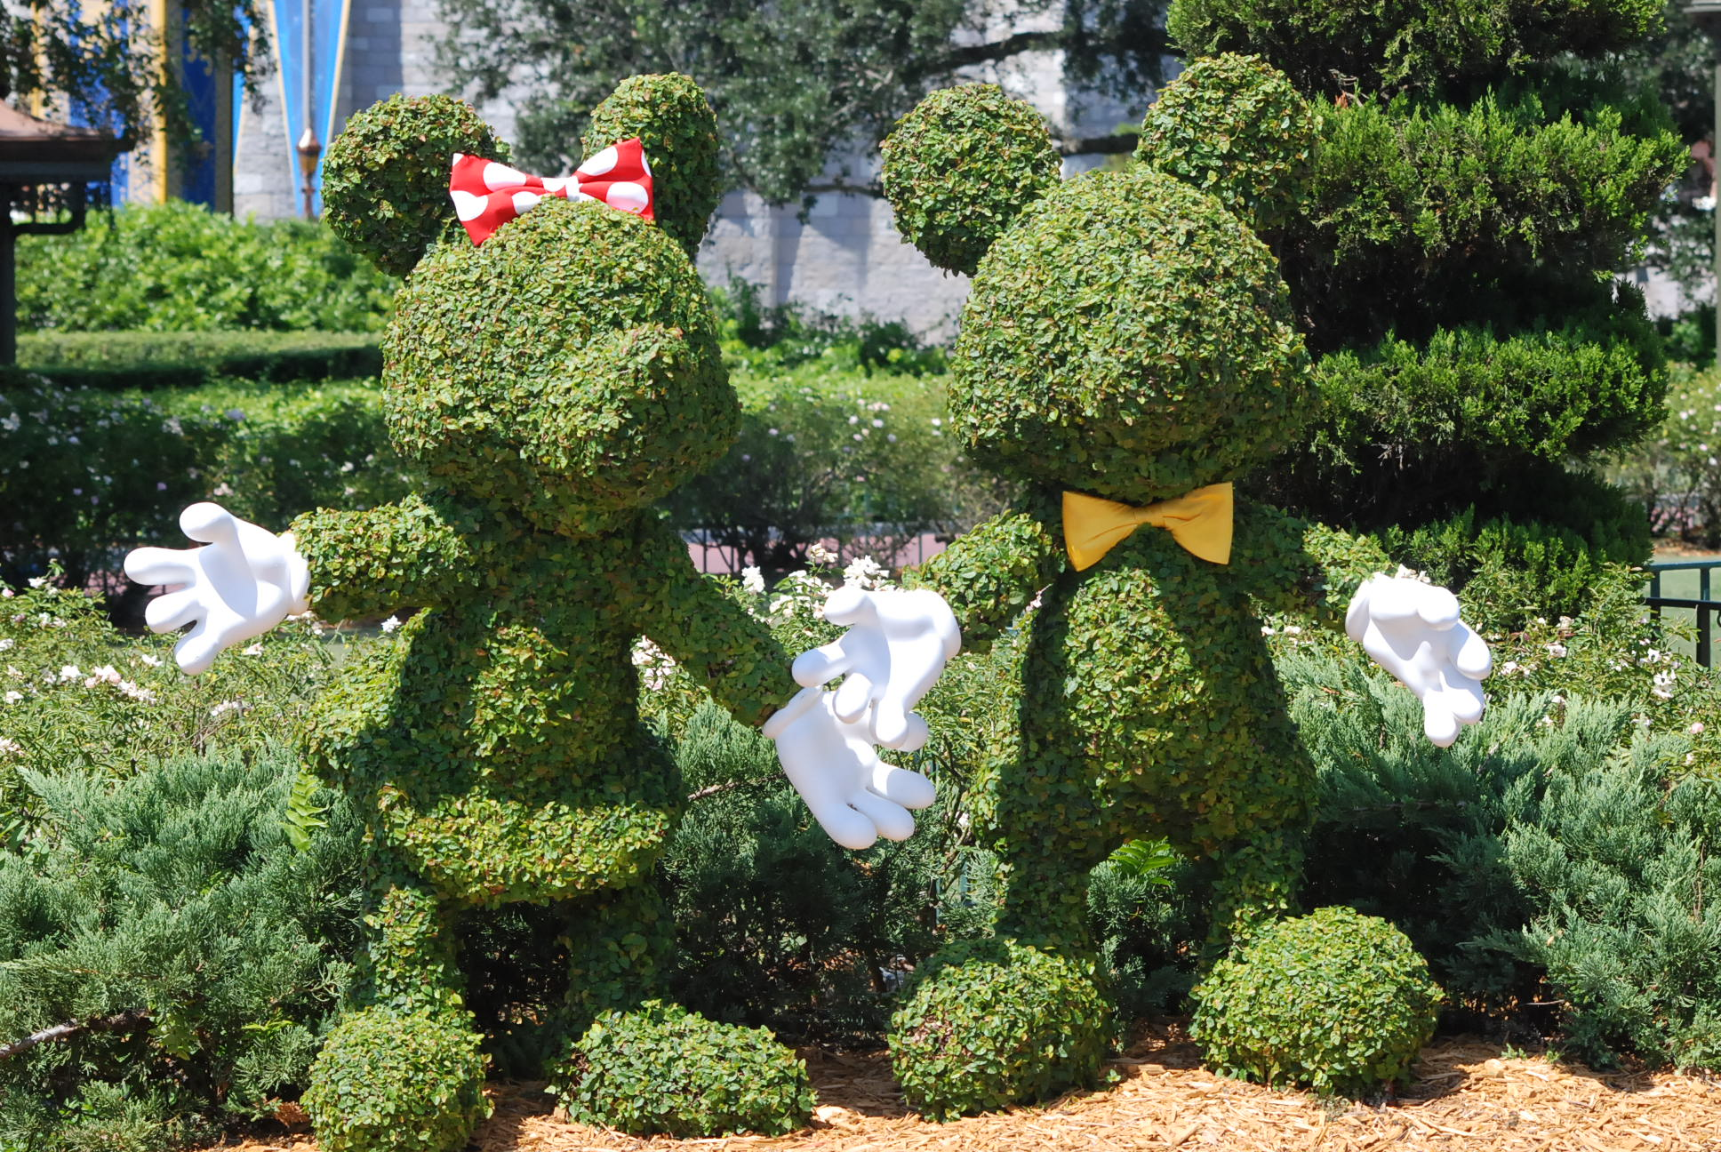
Notes:
You can picture the hedge that’s cut to look like Mickey Mouse. What do the restrooms look like? I’ve done this presentation for 1000’s of people and no one has ever said that the restrooms were dirty. What about the ride operator. Let me tell you what the grooming standard is for a male ride operator at Disney. Hair can not touch the back of the collar in a standing position. No facial hair except a moustache and if you have a moustache it has to be trimmed above the lip. No VISIBLE body tattoos or body piercings of any kind, including a pierced tongue. Why is that?
FORWARD

Slide 80
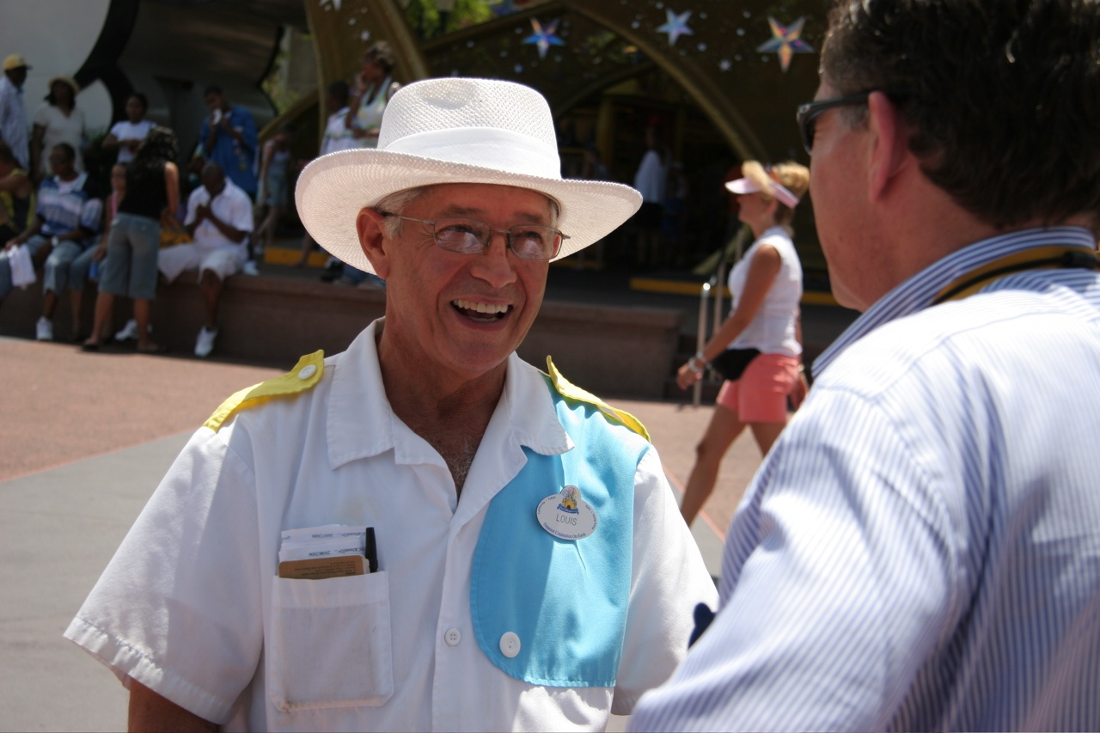

Slide 81
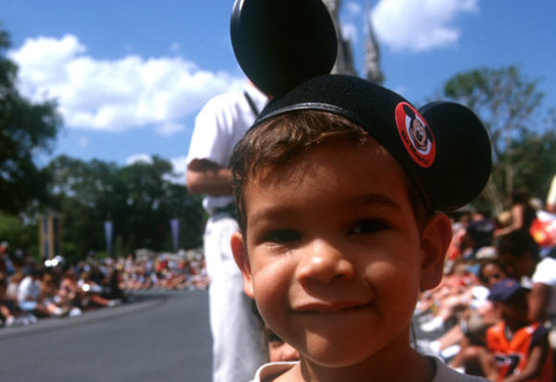
Notes:
Because Disney understands their customer. When mom and dad and the kids are in Orlando deciding to go to Universal, Sea World or Disney, who chooses? Mom or Dad? Mom. Disney knows that the mother is the decision maker. And what are the two things important to the MOM when bringing her children to an unfamiliar place? #1 is SAFETY. So that is why EVERYONE at Disney is dressed in costNorthwoode so that if a child gets lost, he or she will gravitate to someone in costNorthwoode instead of someone dressed like US on vacation. What’s #2 important to Mom - Cleanliness. That’s why Disney makes sure that their restrooms are immaculate. And WHY the strict grooming standard?
FORWARD

Slide 82

Notes:
Because Disney knows that if you aren’t being brought to Disney by your parents, you’re being brought by your GRANDPARENTS. Ask any grandparent, would you mind leaving your grandchild with that employee, you see, the one over there with the long hair, tattoos and body piercings, what is Grandma going to say? “No way, if he’s not ON drugs, he’s probably selling drugs.” That employee could be THE MOST POLITE person, but it doesn’t matter. All that matters is how Grandma FEELS. And HER FEELINGS ARE HER FACTS.
FORWARD

Slide 83
70%
Cost
Location
Reputation
…of customer
brand perception
is determined by experiences with
PEOPLE
Source: Ken Irons, Market Leader

Slide 84
70%
…of customer
brand perception
is determined by experiences with
PEOPLE
Reputation

Slide 85
Why Customers Quit
68%
Quit because of an
attitude of indifference
toward the customer
by the owner, manager
or some employee.

Slide 86
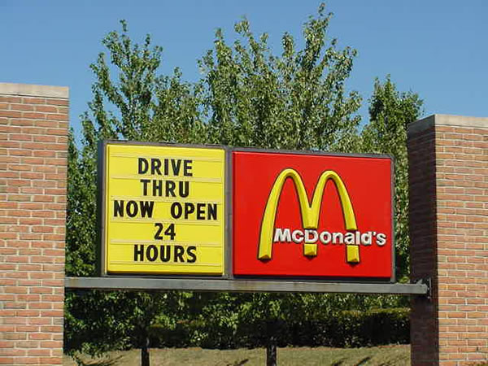

Slide 87
Why Customers Quit
68%
Quit because of an
attitude of indifference
toward the customer
by the owner, manager
or some employee.

Slide 88
To the student
You are your Community College

Slide 89
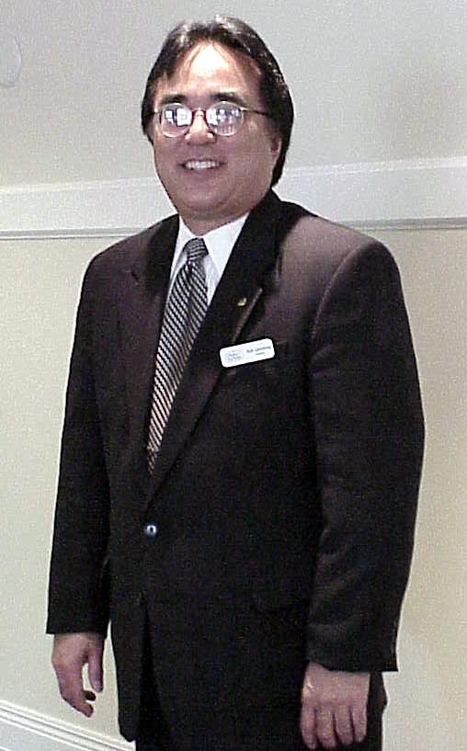
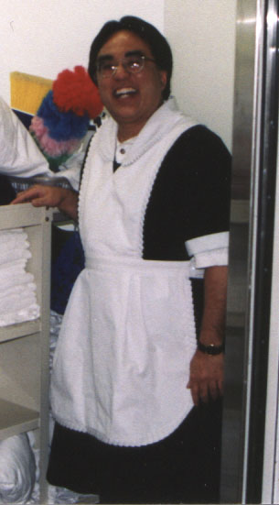
You are Your College.
Your
appearance
is the largest single factor
(57%)
that
guides that judgment.
Notes:
You also have to define the performance tips. Especially appearance. Perception is reality. So I say to you that I want to GIVE YOU THE PERCEPTION of PROFESSIONALISM. And I walk out looking like this
CLICK FOR EFFECT.
Yes or no. Yes, of course. Boy, if you were hesitating . . . What a tough crowd. But what if I came out dressed like this.
CLICK FOR EFFECT.
A whole different perception. By the way, that is me. The housekeepers claimed that the dress, although cut two inches below the knee was too short. I said, that’s not true. And they said “well, why don’t you try it then.” So I did for a day and worked as a housekeeper They did prove that the dress is too short by showing me those pictures. I just am not going to show them to you.
FORWARD

Slide 90
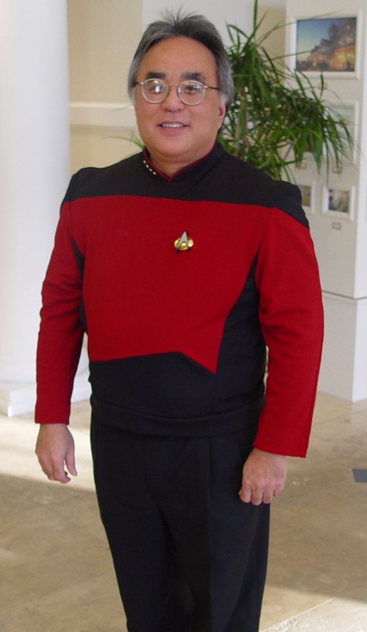
Your appearance should be a reflection
of your professionalism, not your personal style.
Notes:
Your appearance should BE A REFLECTION of your professionalism, not your personal style. But Bill, I like my black fingernail polish. Yes, but some of our customers may not.
FORWARD

Slide 91
Appearance
Eye Contact.
Smile.
Dress for success.
Appropriate tone of voice.
Proper body language.
Simple manners.
Notes:
Appearance is not just what you look like. It is also about all this:
Eye Contact.
Smile.
Dress for the job you want, not he job you have.
Appropriate tone of voice.
Proper body language.
Simple manners.
I am going to focus on two
FORWARD

Slide 92
People buy from
people they know
people they like
people they trust
And people who want
their business
Notes:
PEOPLE DON’T BUY FROM COMPANIES. PEOPLE STILL BUY FROM People they know, People they like, People they trust and People who want their business AND
FORWARD

Slide 93
Appearance
Eye Contact.
Color of their eyes.
Smile.
Great!!!
Notes:
People buy from people they like. A smile drives the perception of likeability. How can you show a Duchenne smile?
CLICK FOR EFFECT
When someone asks you “How are you?” establish eye contact, look right at him or her, and say “Great!!!”
YOU SEE, you can’t help showing your teeth and driving a Duchenne smile when you say Great!! Act it like you mean it and you will make your customer feel better, too. In fact, I believe this is such a strong driver of emotional connection that I will tell you that YOU WILL NOT BE ABLE TO SLEEP TONIGHT unless you remember tomorrow morning after you brush your teeth, look in the mirror, say three times. GREAT ! Great ! Great! You’ll get to see what that looks like and feel like. Imagine if you had your whole team together listening to this and tomorrow morning you all say it like you mean it when someone asks you How are you? What kind of day would your team have? Great! What kind of day would your customers calling you have that day? Great!
By the way, can you hear a smile over the phone? Of course you can. In our reservations center, we put a small mirror in front of every agent that said, “Remember, when you pick up this phone, YOU ARE THE COMPANY, smile, and think “Great!”
Remember, you will not be able to sleep tonight . . .
FORWARD

Slide 94

Notes:
This is Mari Smith. Another sidebar. Mari Smith is the queen of Facebook marketing and she put out a book just last week that I also highly recommend about Relationship Marketing.
CLECK FOR EFFECT
But do you see her crows feet. Turns out that A crows feet smile is considered the real SPONTANEOUS, genuine smile.
And there is a benefit for you as well. A 30-year long study found that women who displayed the Duchenne smile in their college yearbook photos had greater levels of well-being and marital satisfaction three decades later. For the men, another study found that professional baseball players who sported Duchenne smiles in their yearbook photo were only half as likely to die, in any given year, as those who had not. So forget the botox and spread the Duchenne smile.
FORWARD

Slide 95
Ten Five Rule
Notes:
Everything Speaks. You have to pay attention to EVEN the smallest detail. Get rid of ANY dissatisfiers, no matter how small. Continually ask yourself WWWBLL, WWWBLL, what would World’s Best look like and work hard to deliver that.
FORWARD

Slide 96
Remove the Dissatisfiers.
Forbidden Phrases
Okay.
No problem.
Transfer
You’ll have to . . .
May I help you?
Notes:
Other performance tips that should be in the customer service handbook are the scripts to include the Forbidden Phrases.
Okay. Is the World’s Best “okay”. Of course not. Very good. Absolutely. My pleasure. But NEVER Okay.”
No problem. You know what the customer is hearing? You weren’t as much of a problem as I thought you’d be.
Transfer . . Let me transfer you to voice mail oblivion, you’ll never hear a live voice again. Let me connect you . .
You’ll have to . . . Does your customer have to do anything?
May I help you? Of course, I need help or they wouldn’t be standing in front of you? HOW may I help you?
FORWARD

Slide 97
Remove the Dissatisfiers.
Forbidden Phrases
That happens all the time.
The policy is . . .
To be honest with you . . .
I think . . . I believe . . .
Notes:
That happens all the time. The hotel didn’t have the most recent rooming list. That happens all the time with that hotel. Well, if it happens all the time, why don’t you fix it.
The policy is . . . Be Your Customer. What do you think when you hear the word policy. What you’re about to tell me, I’m just going to like. JUST DON’T USE THE WORD POLICY.
To be honest with you . . . because I lie to you the rest of the time
I think . . . I believe . . .
Do you know what the customer is hearing. “I have no clue. Here is my best guess.”
FORWARD

Slide 98
Great Service
is
Great Theater

Slide 99
One person can make a difference and every person should try.
John F. Kennedy

Slide 100
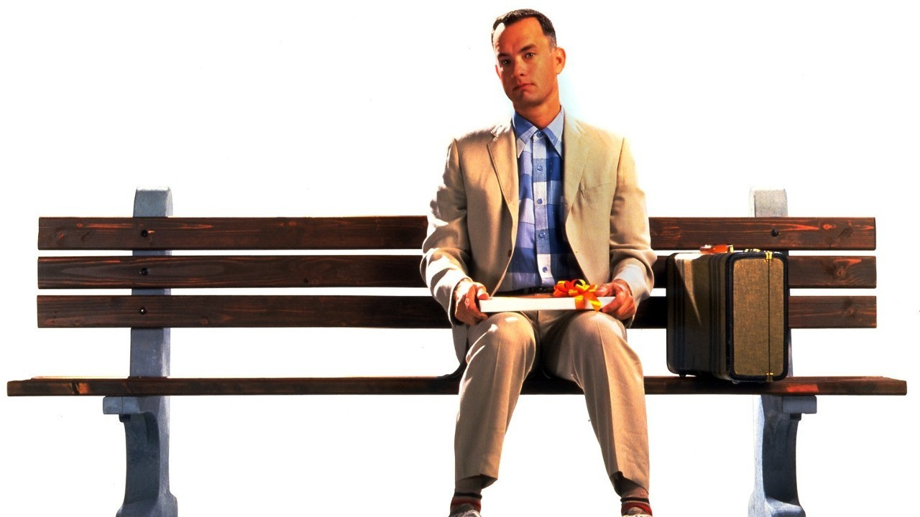

Slide 101
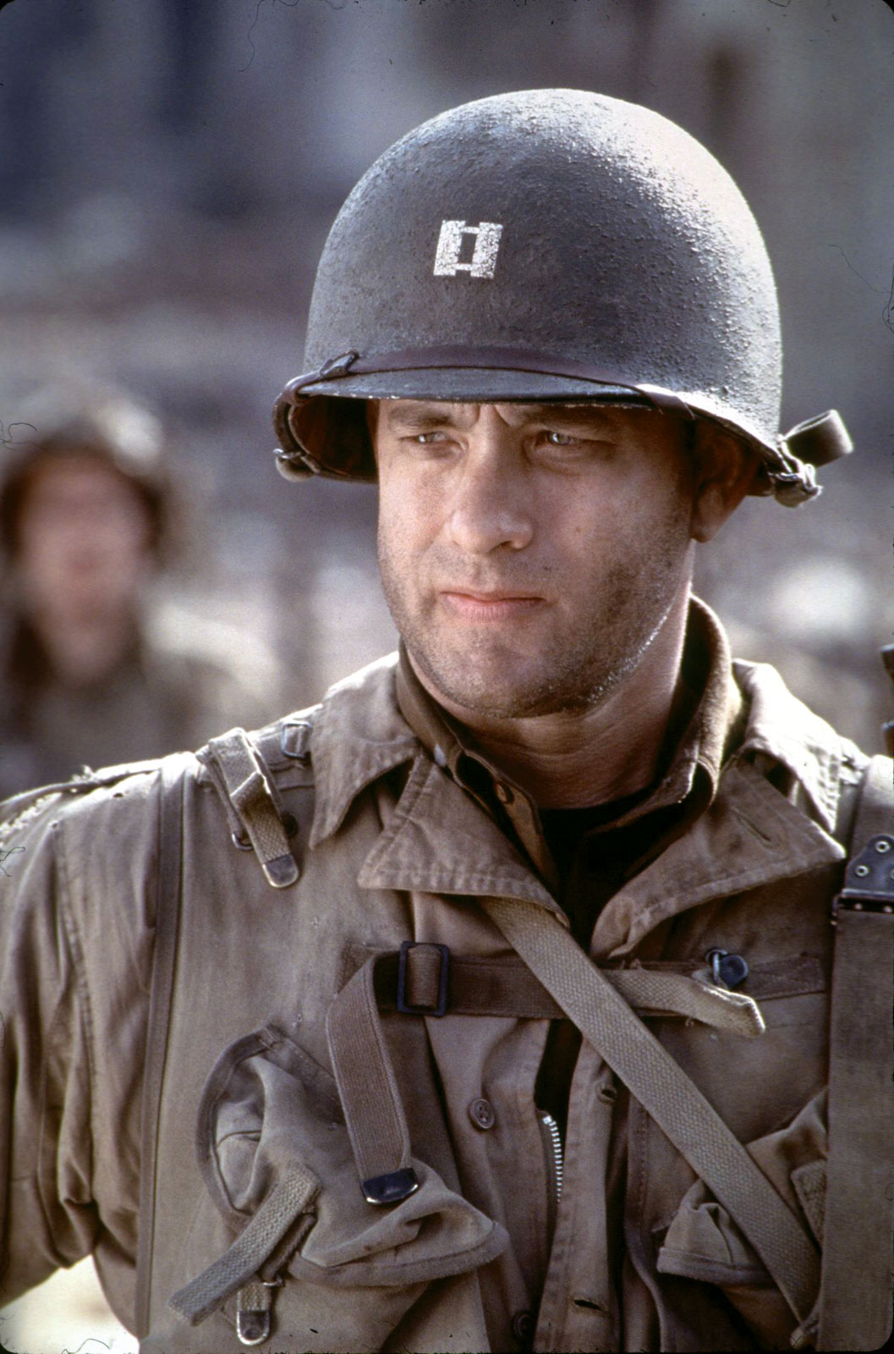

Slide 102
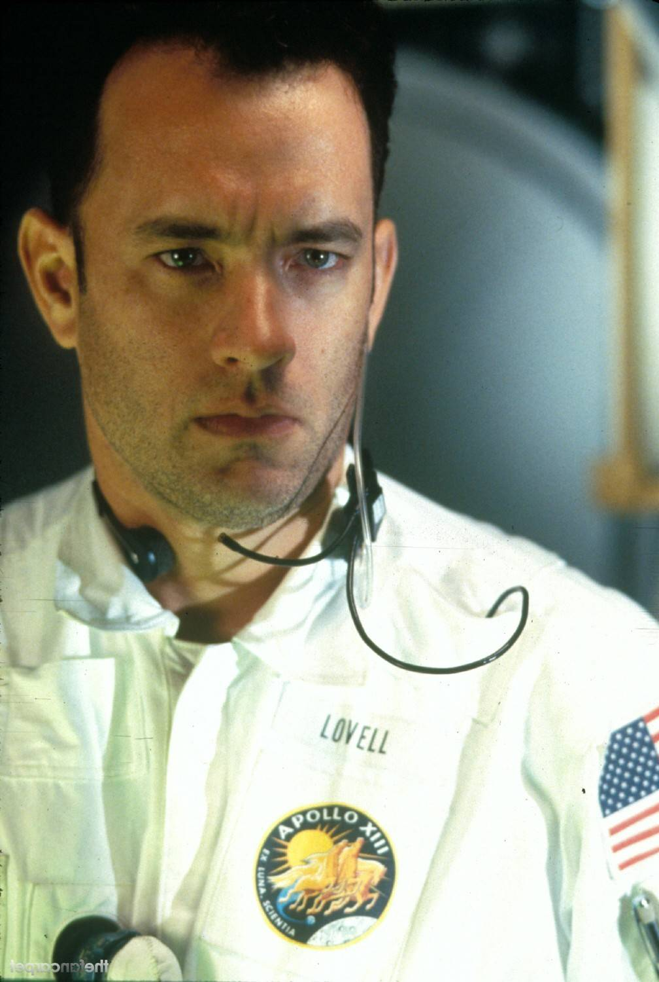

Slide 103
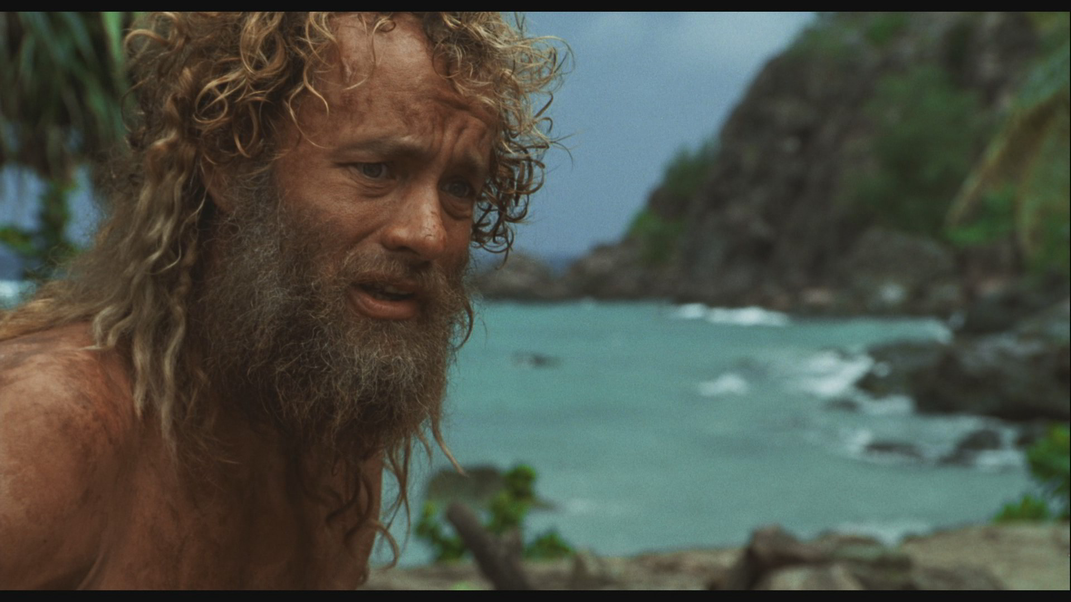

Slide 104
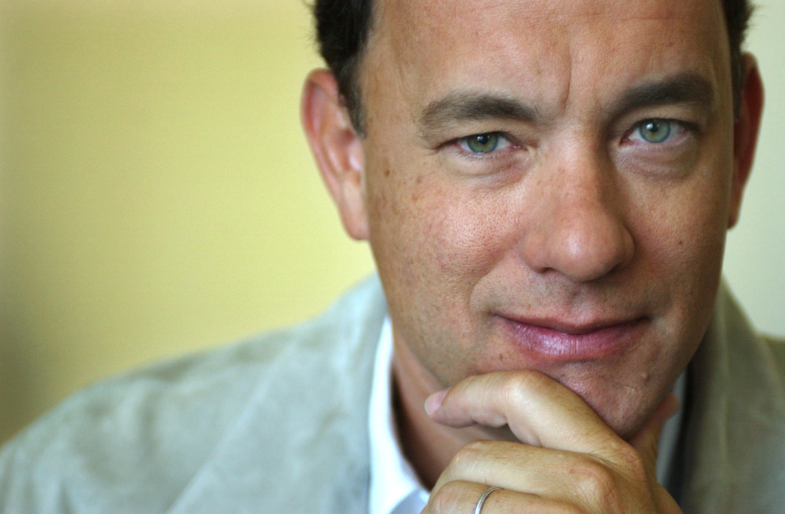

Slide 105
Great Service is Great Theater
Act it like
you mean it.
Notes:
Start BY removing all the dissatisfiers.
FORWARD

Slide 106
People buy
with emotion
and justify
their decision with reason.

Slide 107

Notes:
Calgon moment, bubble bath surrounded by candles, listening to Kenny G. So I tell you I’ll get you the candles and I go out and get these. . .
FORWARD

Slide 108

Notes:
Priceless. How much was it again?
FORWARD

Slide 109
Notes:
Priceless. So I only have one question for you?
FORWARD

Slide 110
What is your
college’s
“priceless”?

Slide 111
What is
YOUR
“priceless”?

Slide 112
One person can make a difference and every person should try.
John F. Kennedy

Slide 113
There is a difference between taking care of a student and caring for a student.

Slide 114
How do you create an experience that will
emotionally bond
your student
to college?

Slide 115
Do you care about me?

Slide 116
Principle Two
Create Their Experience

Slide 117
-PAUSE-
FOR THIS VERY IMPORTANT
LEADERSHIP
ANNOUNCEMENT

Slide 118
If you’re not taking care of the student, you darn well better
be taking care
of the person who is.

Slide 119
If the only thing
your employees
get out of their job
is a paycheck,
you, as a leader,
have failed.

Slide 120
Why is this critical
in today’s labor market?
48% leave because they don’t feel appreciated
61% said their bosses don’t value them
88% said they don’t receive enough acknowledgment for the work they do

Slide 121
Lack of
recognition
and communication

Slide 122
37% said they have a clear understanding of what their organization is trying to achieve and why
20% was enthusiastic about their team’s goals
Only 15% feel their organization fully enables them
Only 20% fully trusted their organization

Slide 123
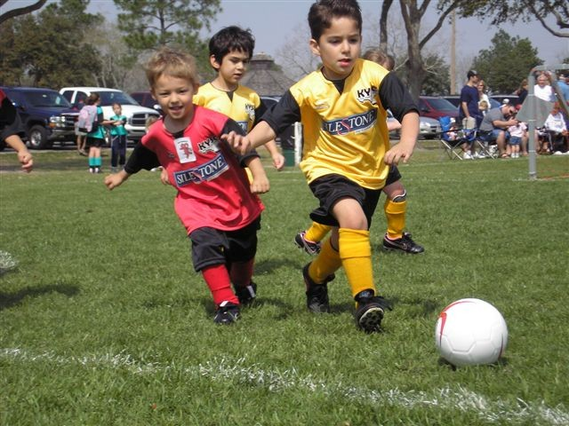

Slide 124
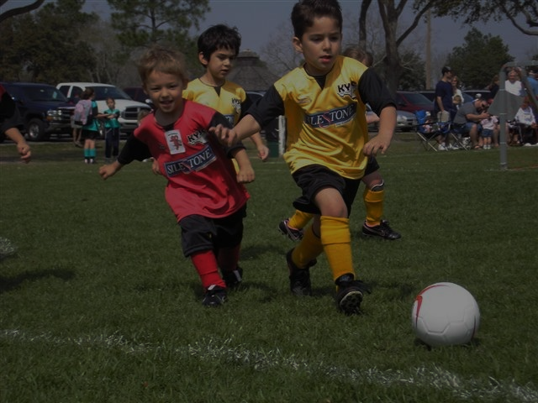
Only 4 o fthe 11 players would know which goal is theirs
Only 2 of the 11 would care.
Only 2 would know what position they play and what they should do
All but 2 would be competing with their own team members rather than their opponent.

Slide 125
What one thing …
Recognition

Slide 126
Without
involvement
there is
no commitment.

Slide 127
So how
do you do it?

Slide 128
Three Building Blocks for a
Superior Service culture
Management Commitment
Customer Feedback
Employee Performance

Slide 129
Three Building Blocks for a
Superior Service culture
Management Commitment
Customer Feedback
Employee Performance

Slide 130
Three Building Blocks for a
Superior Service culture
Management Commitment
Student Feedback
Employee Performance

Slide 131
Remove the Dissatisfiers.
What one thing . . .
“What one thing
could we do to make
your student experience more enjoyable?”

Slide 132
Three Building Blocks for a
Superior Service culture
Management Commitment
Customer Feedback
Employee Performance

Slide 133
Our team
is a highly disoriented group
of back-stabbing,
“you’ll go down before I go down” individuals
with highly charged emotions
having a disjointed sense of mission
who are working against each other
to maintain their own
personal turfdoms.

Slide 134
Our team
is a highly communicative group
of service professionals
with different skills, and abilities having a shared sense of mission who are working together
to achieve clearly defined goals.

Slide 135
Select the right people.
It’s a lot easier to find
nice people than it is to train people to be nice.

Slide 136
Recruit the right people, train them, continually communicate with them, ask their opinion, involve them, recognize them, and celebrate with them. If you show respect for their opinions and you involve them, they will be proud of what they do and they will deliver quality service to your Guests.
Walt Disney

Slide 137
Ordinary people
Ordinary systems
Ordinary experiences

Slide 138
Ordinary people
Extraordinary systems
Extraordinary experiences

Slide 139
“Keeper
of the culture”

Slide 140
When values
are clear,
decisions are easy.
Roy Disney

Slide 141
Clear Mission Shared Vision

Slide 142
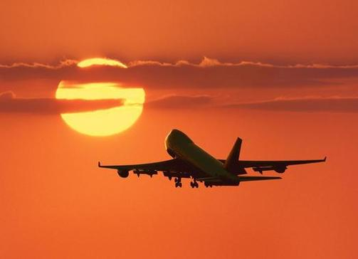
Notes:
Ladies and Gentlemen, welcome aboard WWBLL airlines. This is your captain speaking, Bill Quiseng. A little bit about our trip. We’ll be traveling at an altitude of 35,000 feet at a speed of 500 miles an hour. As your captain, I do have to tell you one little thing. I have NO idea where we’re going. Do your employees know where YOUR COMPANY is going?
FORWARD

Slide 143
If you could get all the people
in an organization
rowing in the same direction,
you could dominate
any industry, in any market,
against any competition,
at any time."
Notes:
Imagine if you could get all the people in your organization rowing in the same direction,
you could dominate any industry, in any market, against any competition, at any time." If everyone of your team were on the same page, you’d easily become the World’s Best for your customers.
FORWARD

Slide 144
“Keeper
of the culture”
Put it in writing.

Slide 145
Service Handbook
Mission
Values
History or Heritage
Performance Tips
Service Recovery
Glossary
Notes:
So how do you get everyone on the same page. You’ve got to WRITE THE BOOK on customer service for your company. It should include at least these key components. THIS is NOT your employee handbook. If you want to STEP UP to being World’s Best then you need TO SEPARATE customer service from everything else. When you do THAT, you prioritize taking customer service TO THE TOP. Writing the handbook is not easy. But as I said in the very beginning, It is about COMMITMENT.
FORWARD

Slide 146
Service Handbook
Mission
Values
History or Heritage
Performance Tips
Service Recovery
Glossary
Notes:
So how do you get everyone on the same page. You’ve got to WRITE THE BOOK on customer service for your company. It should include at least these key components. THIS is NOT your employee handbook. If you want to STEP UP to being World’s Best then you need TO SEPARATE customer service from everything else. When you do THAT, you prioritize taking customer service TO THE TOP. Writing the handbook is not easy. But as I said in the very beginning, It is about COMMITMENT.
FORWARD

Slide 147
Service Handbook
Mission
Values
History or Heritage
Performance Tips
Service Recovery
Glossary
Notes:
So how do you get everyone on the same page. You’ve got to WRITE THE BOOK on customer service for your company. It should include at least these key components. THIS is NOT your employee handbook. If you want to STEP UP to being World’s Best then you need TO SEPARATE customer service from everything else. When you do THAT, you prioritize taking customer service TO THE TOP. Writing the handbook is not easy. But as I said in the very beginning, It is about COMMITMENT.
FORWARD

Slide 148
L
E
A
R
N
isten
mpathize
pologize
espond
otify
Notes:
So how do you get everyone on the same page. You’ve got to WRITE THE BOOK on customer service for your company. It should include at least these key components. THIS is NOT your employee handbook. If you want to STEP UP to being World’s Best then you need TO SEPARATE customer service from everything else. When you do THAT, you prioritize taking customer service TO THE TOP. Writing the handbook is not easy. But as I said in the very beginning, It is about COMMITMENT.
FORWARD

Slide 149
Practice
CBWA

Slide 150
Two questions
What are you hearing?
What can I do for you?

Slide 151
- NOW -
BACK TO YOUR REGULARLY SCHEDULED PROGRAM

Slide 152
What business
is your community college in?
The
Experience
Business
Notes:
You are not in the supplier business or the provider business.
CLICK FOR EFFECT
You are in the Experience business. And . . .
FORWARD

Slide 153
The customer
is paying
for his experience,
not yours.
Notes:
The customer is paying for his experience not yours. This is a key concept. Since you are working with groups, in order to drive customer loyalty, you need to create an EXPERIENCE for each group member, not just the group lead.
I get THAT WE ARE ALL DOING MORE WITH LESS. I know we have ALL had cutbacks, possibly even had some layoffs. There may be some days that staff call in sick. THE CUSTOMER DOESN’T CARE. Those issues are YOUR experience. The customer only cares about HIS experience, not yours.
Let me give you one example of how we solved it. When a bus tour group arrived, we announced an IPT call over our walkie-talkies. IPT stood for I Practice Teamwork. When an IPT call was made, everyone had a role that was pre-determined. Administrative staff assisted check-in, maintenance and security people served as elevator operators and housekeepers and sales managers on each floor assisted guests to their rooms. We did the same thing for breakfast. Everybody became a busser or poured coffee. Was that an inconvenience for the admin staff or the maintenance people, Of course. But it DIDN’T matter. We all understood the customer is paying for his experience not yours.
FORWARD

Slide 154
It’s never
about you,
It’s always
about them.
Notes:
Remember, it is NEVER about you. It is always about them. Do you feel like you WANT to come to work EVERY DAY you are scheduled, your birthday, the holidays, even sometimes on your day off. Of course not, but does the customer care? Of course not. Don’t take this personally, but they don’t care how YOU feel. They only care how THEY feel. It is never about you. It is always about them.
FORWARD

Slide 155
Great Service
is
Great Theater

Slide 156


Slide 157
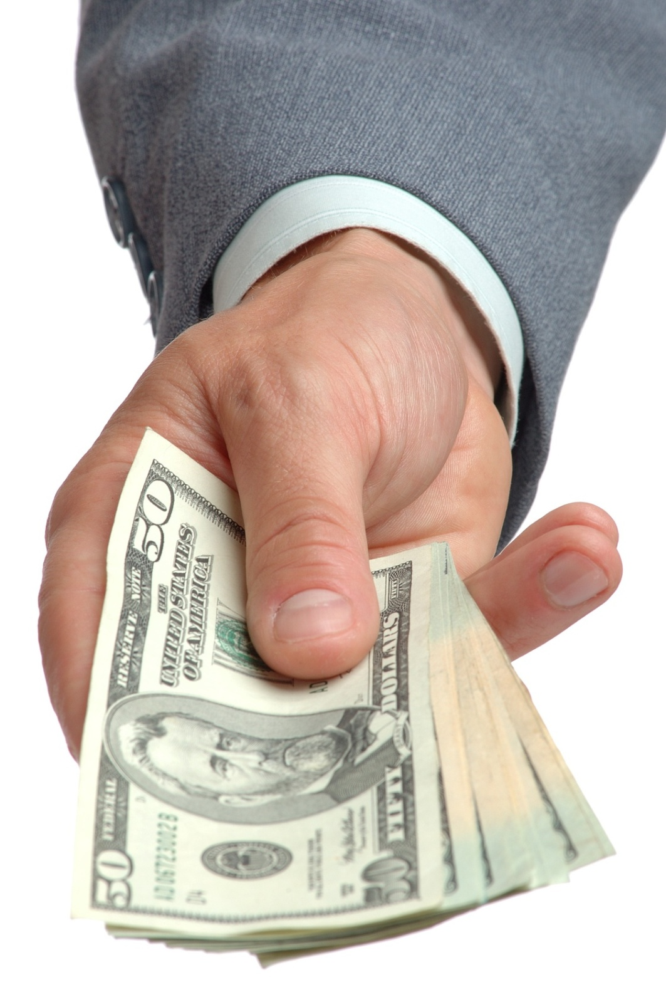

Slide 158
No student pays tuition,
walks on campus
and then says,
"Dissatisfy me now."
Aim for
100% satisfaction.

Slide 159
What business
is your community college in?
The
Experience
Business
Notes:
You are not in the supplier business or the provider business.
CLICK FOR EFFECT
You are in the Experience business. And . . .
FORWARD

Slide 160
What business
is your community college in?
The
Experience
Business
Notes:
You are not in the supplier business or the provider business.
CLICK FOR EFFECT
You are in the Experience business. And . . .
FORWARD

Slide 161
Student Experience
Transportation
Experience
Parking
Experience
Food Service
Experience
Registration
Experience
Instructor
Experience
Classroom
Experience
Cyberspace
Experience
Restroom
Experience
Library
Experience
Graduation
Experience
Financial Aid/Cashier
Experience

Slide 162
You cannot begin
to satisfy customers until you remove all the dissatisfiers.
Notes:
Start BY removing all the dissatisfiers.
FORWARD

Slide 163
Remove all the dissatisfiers.
What one thing
could we have done
to make your experience more enjoyable?
Notes:
And if you think there are no dissatisfiers in your experience, ask your customers, “What ONE thing could we have done to make your experience more enjoyable?” And work hard to eliminate ANYTHING they bring up because ANY ONE THING they bring up is a dissatisfier.
FORWARD

Slide 164
Everything
Speaks
Notes:
Everything Speaks. You have to pay attention to EVEN the smallest detail. Get rid of ANY dissatisfiers, no matter how small. Continually ask yourself WWWBLL, WWWBLL, what would World’s Best look like and work hard to deliver that.
FORWARD

Slide 165
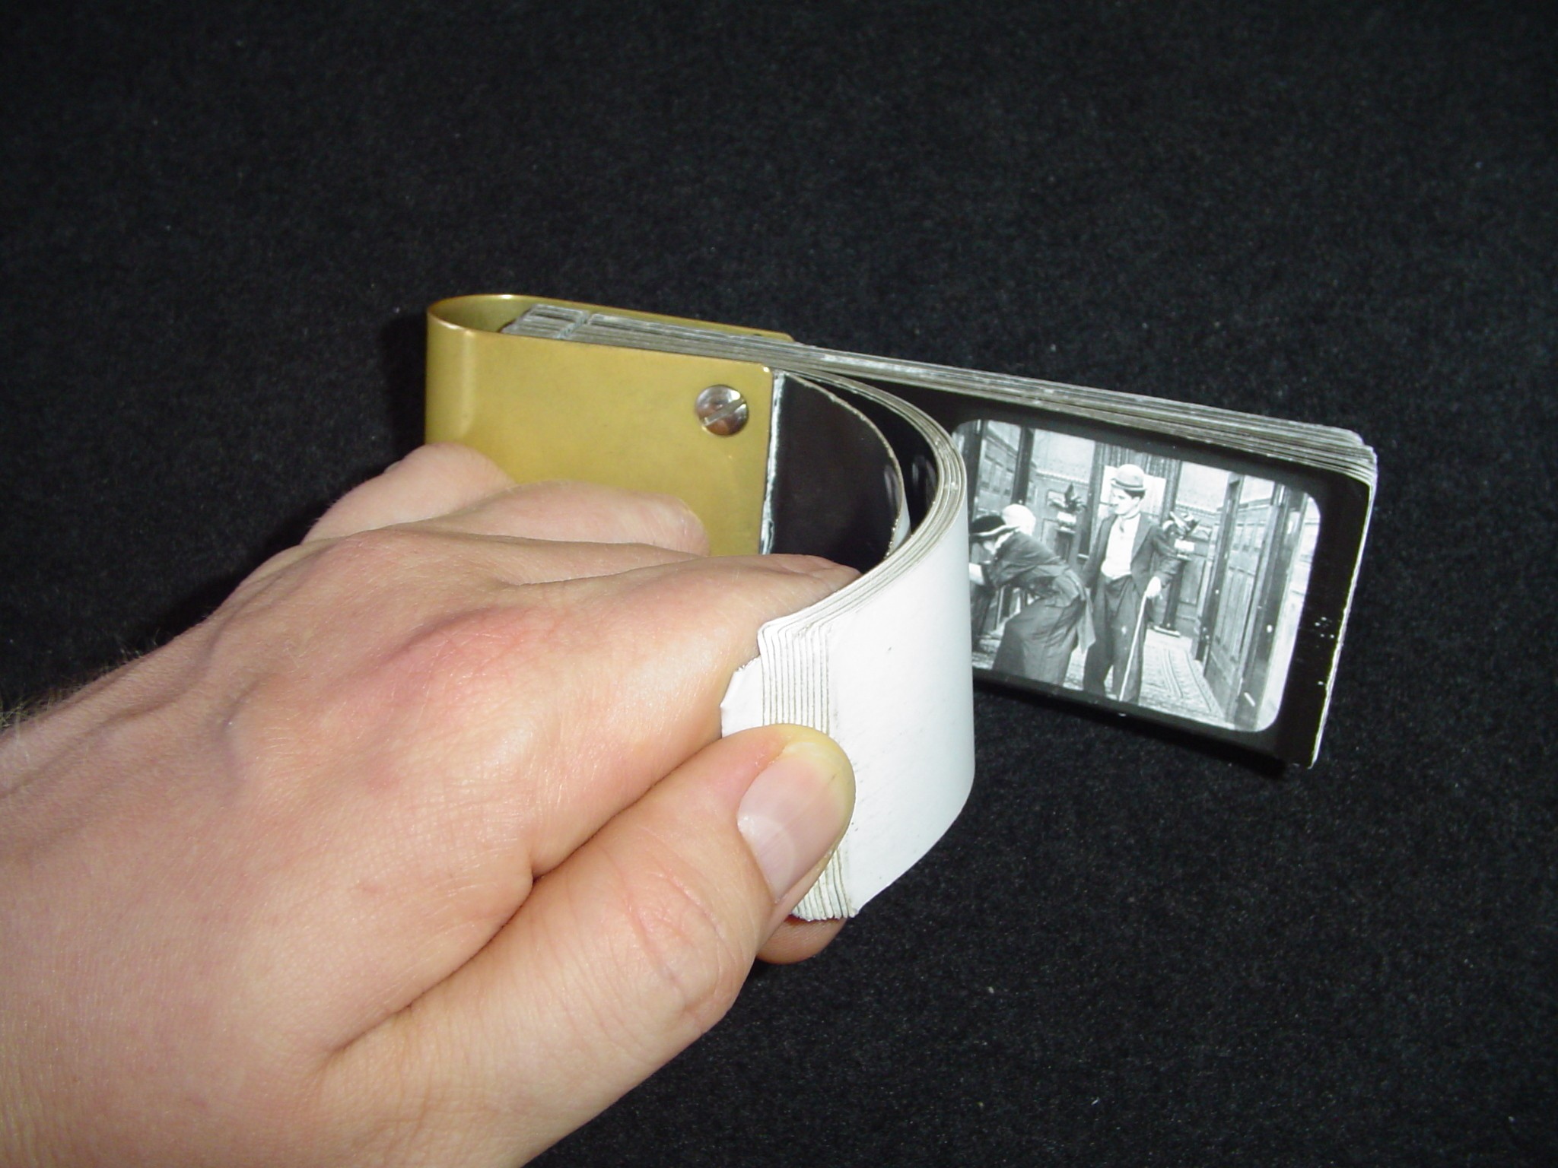
Notes:
Remember those Flipbooks. If one of the pages were
FORWARD

Slide 166
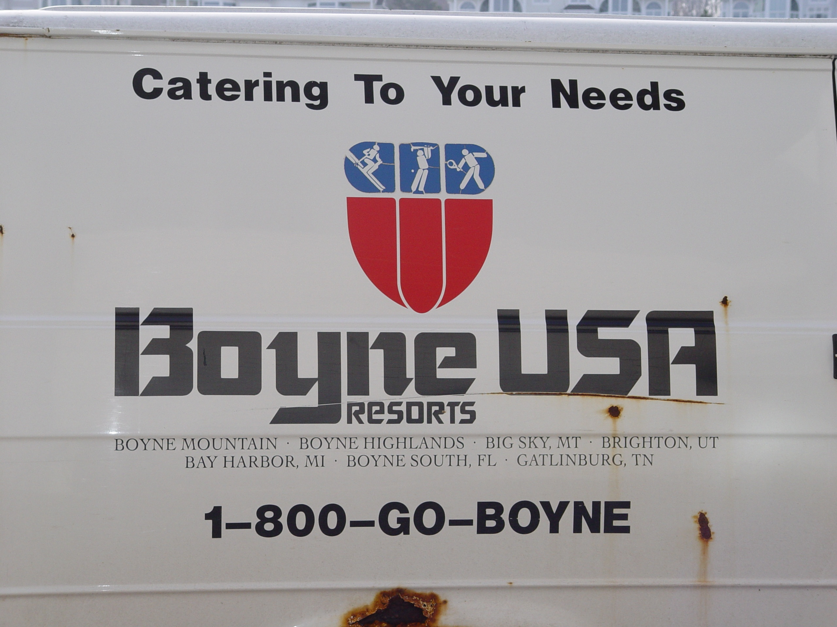

Slide 167
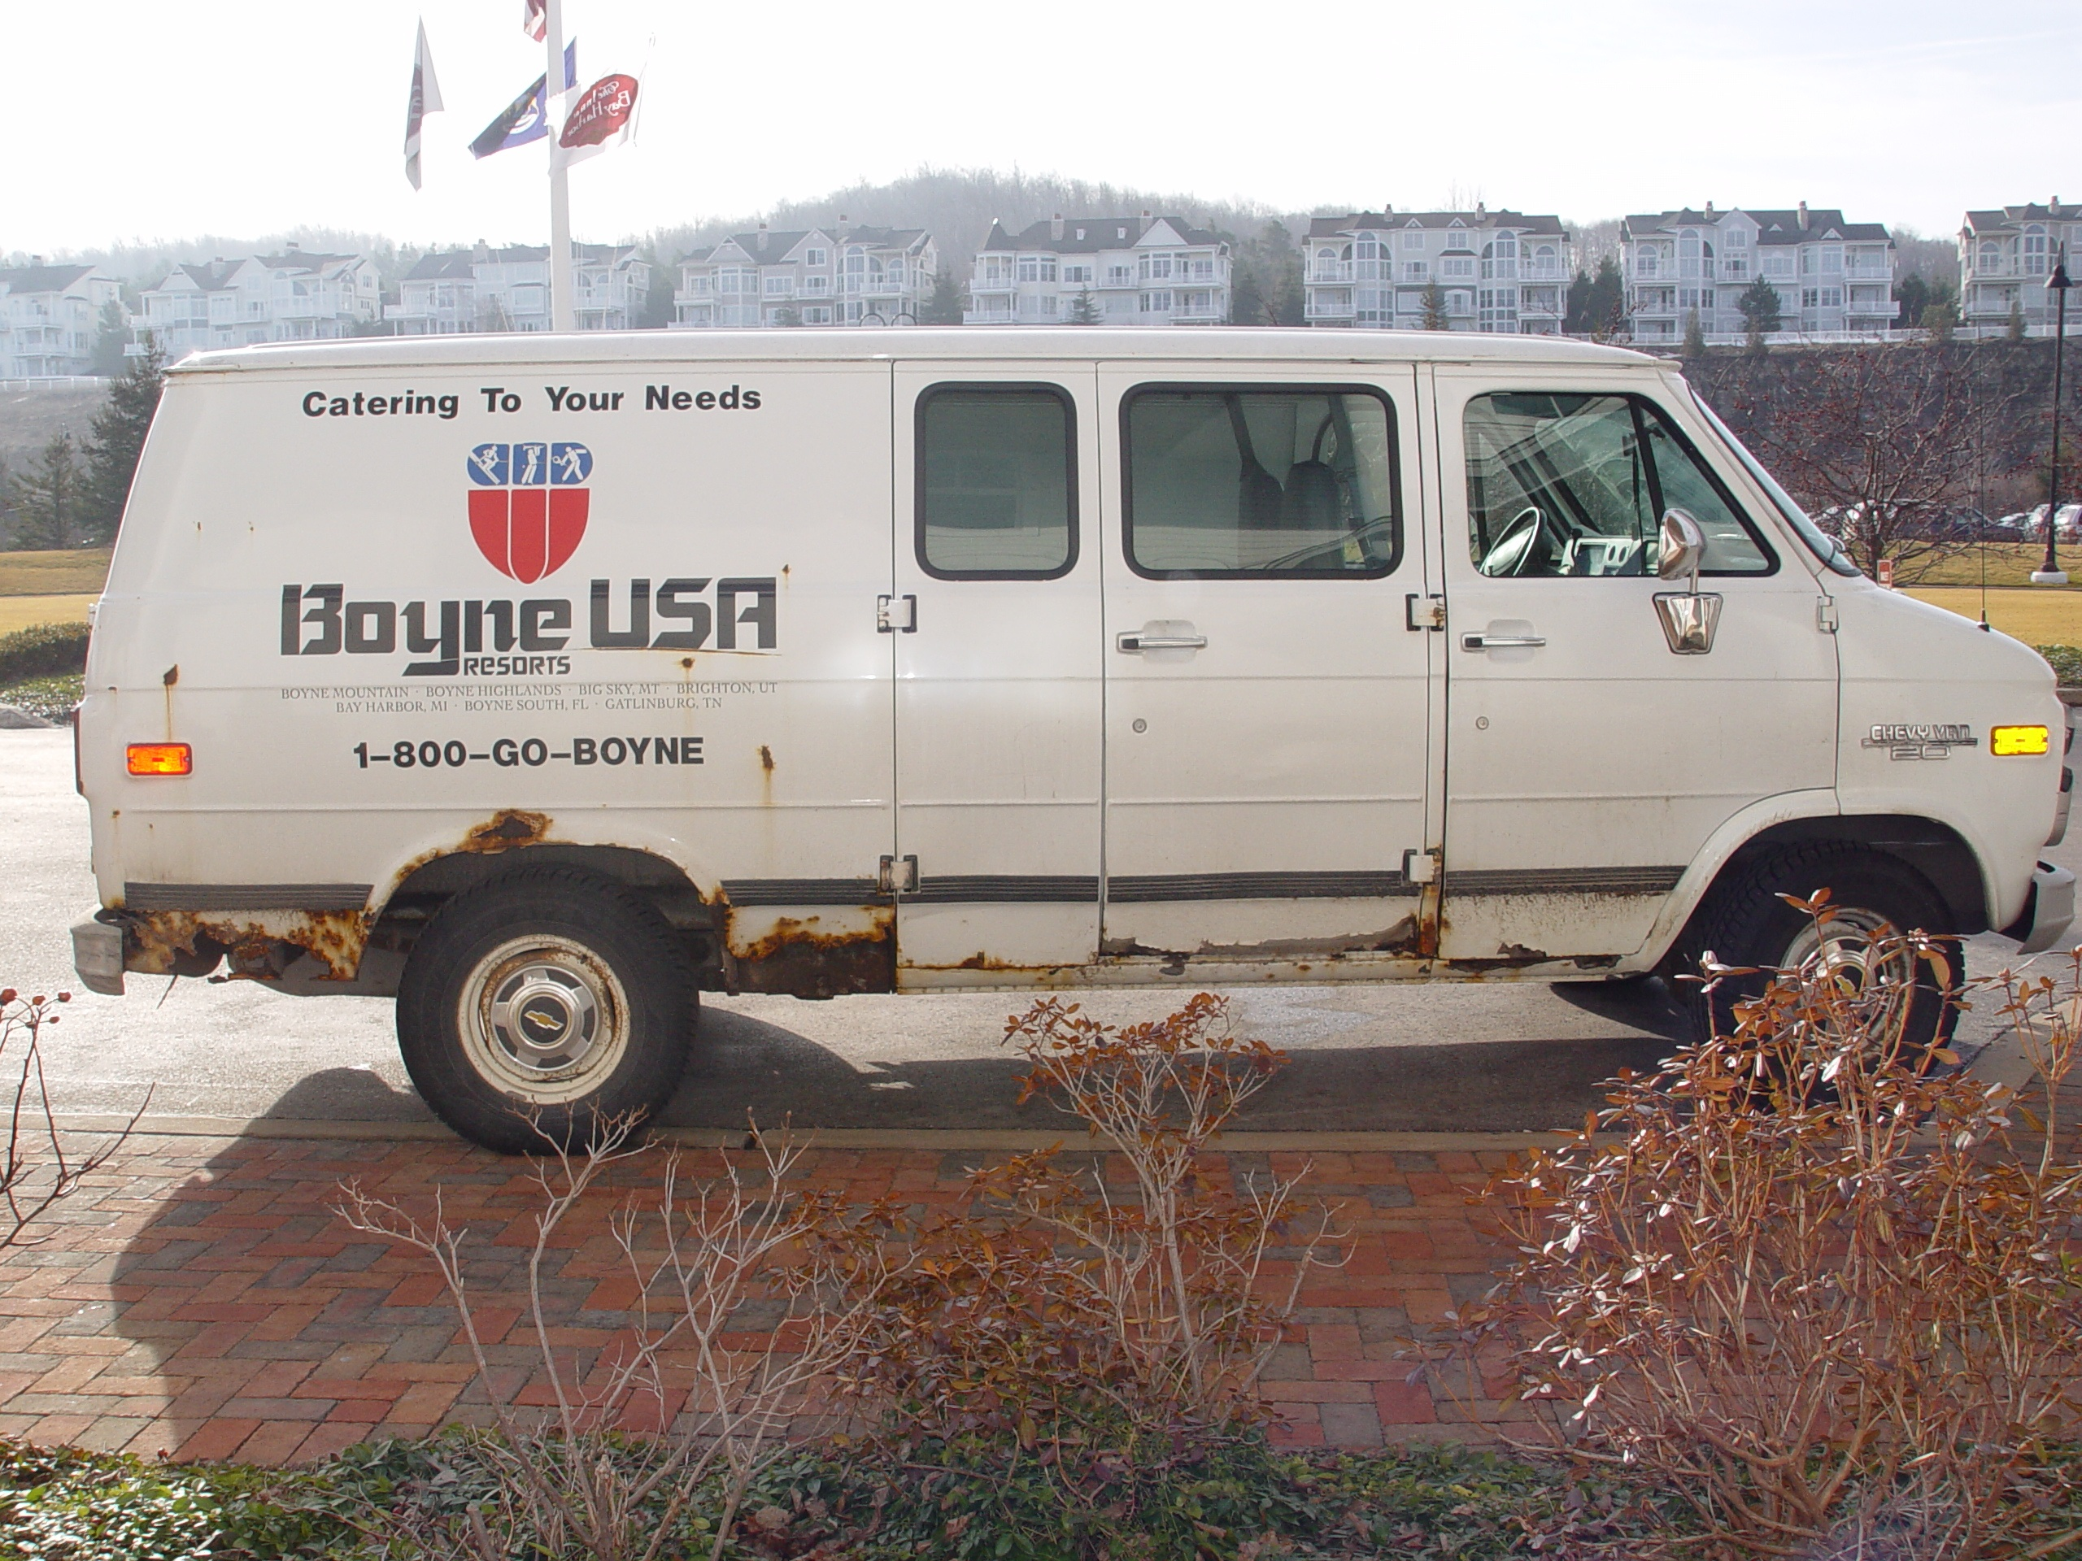

Slide 168
Your College’s
Student Experience
School vehicles
Parking lot
Restrooms
Library
Website
Voice Mail

Slide 169

Notes:
Be your customer:
In a phone conversation, there are two people on the line, your customer and you. Who is more important? If you have one of those “I am either away from the desk or on the phone” you’re saying to your customer, “I’M SO IMPORTANT that I have to tell you where I am even when I’m not here.”
So what should it sound like? How about something like this:
FORWARD

Slide 170
“At Your Service, this is Your Name, Your Position for Your Community College. I apologize that I’m unable to take your call personally at this time. Press the one key at any time to begin recording. My email address is S-P-E-L-L-O-U-T @YourCC. If you wish, please leave your name and number and the best time to contact you, and I will return your call. Thank you for calling.”
Notes:
“At Your Service, this is Bill Quiseng, Chief Experience Officer for billquiseng.com. I apologize that I’m unable to take your call personally at this time. Press the one key AT ANY TIME to begin recording. My email address is billq @billq-u-i-s-e-n-g.com. If you wish, please leave your name and nNorthwoodber and, THE BEST TIME TO CONTACT YOU, and I will return your call. Thank you for calling.”
“At Your Service” . . . It’s a reminder to what your role is in the conversation.
“I apologize . . .” What the customer is hearing is: “Since I’m not here to speak to you as you expected, I want to apologize. . .”
“ . . to take your call PERSONALLY . . .”. CUSTOMER SERVICE IS ALL ABOUT RELATIONSHIPS. Given a choice, people would ALWAYS prefer to buy from people THEY KNOW, LIKE, and TRUST. AND PEOPLE like and trust MORE those people who personalize the experience for each individual customer.
“Press the one key. . . ” so that they know what to do on future calls.
“My email address . . . “ Rather than play telephone tag, many callers will send an email immediately after hanging up.
“. . . The best time to call you.” I want to serve you when it is convenient for you.
“Thank you for calling.” People buy from people who want their business. How do you show someone you want their business? Just say “Thank you.”
FORWARD

Slide 171
No
Excuses
Notes:
Everything Speaks. You have to pay attention to EVEN the smallest detail. Get rid of ANY dissatisfiers, no matter how small. Continually ask yourself WWWBLL, WWWBLL, what would World’s Best look like and work hard to deliver that.
FORWARD

Slide 172
You cannot begin
to satisfy customers until you remove all the dissatisfiers.
Notes:
Start BY removing all the dissatisfiers.
FORWARD

Slide 173
One person can make a difference and every person should try.
John F. Kennedy

Slide 174
You cannot begin
to satisfy customers until you remove all the dissatisfiers.
Notes:
Start BY removing all the dissatisfiers.
FORWARD

Slide 175
Forbidden Phrases
Notes:
Start BY removing all the dissatisfiers.
FORWARD

Slide 176
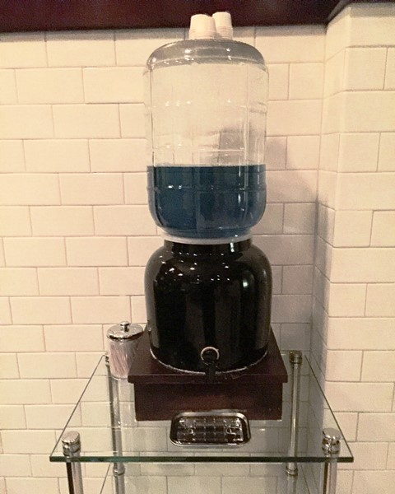

Slide 177
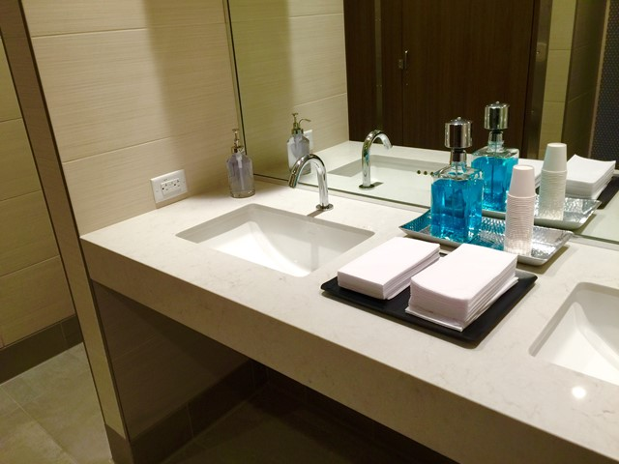

Slide 178


Slide 179
THE LEADERSHIP TEST
Did you recognize someone today? How about a pat on the back or a thank you? Yes or no.
Did you make an impact today? Yes or no. Specifically list what you did to move the business.
How many student contacts did you have today?
Did you teach, counsel, or motivate someone today?
Did you listen today? Yes or no. If yes, write down what you learned.

Slide 180
Did you think about your vision for your team? Yes or no.
Are your people focused? How do you know?
Is each member of your team meeting your expectations? Yes or no. If no, what will be your efforts to improve each person’s performance?
Did you provide a blast of energy, electricity, and excitement today? Yes or no.
Driving home tonight – what is the thing you’re going to do to make your team better tomorrow?

Slide 181
Student Experience
Transportation
Experience
Parking
Experience
Food Service
Experience
Registration
Experience
Instructor
Experience
Classroom
Experience
Cyberspace
Experience
Restroom
Experience
Library
Experience
Graduation
Experience
Financial Aid/Cashier
Experience

Slide 182
It’s hard to be 100% better than your competition, but you can be 1% better in 100 ways.
Rich Melman

Slide 183
It’s not the one big WOW to one customer that wins the day.
It is the one little WOW delivered consistently to every customer.

Slide 184
Student Experience
Transportation
Experience
Parking
Experience
Food Service
Experience
Registration
Experience
Instructor
Experience
Classroom
Experience
Cyberspace
Experience
Restroom
Experience
Library
Experience
Graduation
Experience
Financial Aid/Cashier
Experience

Slide 185
Student Experience
Registration
Bookstore
Library
Orientation
Student Life

Slide 186
Principle Three
Be the Difference
Notes:
So you’ve gotten rid of the dissatisfiers. That gets you to be ONLY as good as your competition. How do you reach the level of being the World’s Best. That’s Principle Three: Be the Difference.
FORWARD

Slide 187
One person can make a difference and every person should try.
John F. Kennedy

Slide 188
Be the Difference.
Do something of value.
Do something helpful.
Do something giving.
Do something unexpected.
Do something creative.
Notes:
Select an experience that’s ordinary and make it a wow. It’s like this . . .
FORWARD

Slide 189
Principle Three
Be the Difference
Notes:
So you’ve gotten rid of the dissatisfiers. That gets you to be ONLY as good as your competition. How do you reach the level of being the World’s Best. That’s Principle Three: Be the Difference.
FORWARD

Slide 190
Five years from now, you’ll be the same person you are today except for the people you meet and the books you read.
Charlie “Tremendous” Jones
Notes:
But Bill I don’t know what to put into my customer loyalty handbook. Well, the late Charlie Tremendous Jones said, Five years from now, you’ll be the same person you are today except for the people you meet and the books you read.” And here is the best book ever written about connecting with customers.
FORWARD

Slide 191


Slide 192
Non-negotiables

Slide 193
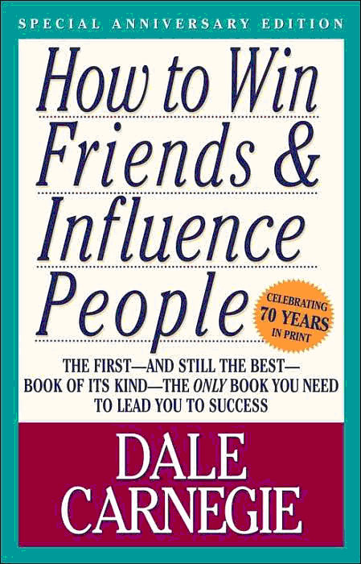
Notes:
Now I know the book was WRITTEN 70 YEARS AGO but don’t read it for content, read it for intent. I believe this is so important that I want to make sure you get the intent. It can be downloaded from my website UNDER PRESENTATION HANDOUTS. It is a one page sNorthwoodmary of the great intent of the best book every written about connecting. Put it somewhere where you can see it every day, share it with your team, and then practice the principles every day.
FORWARD

Slide 194
Make me feel important.
Personalize the Service. Use the Customer’s name whenever possible.
Notes:
You will see that one of the key principles is Make your customer feel important by using the person’s name. As Dale Carnegie put it, “ Remember that a person's name is TO that person the sweetest and most important sound in any language.”
FORWARD

Slide 195
Recognize
People will forget what you said. People will forget what you did.
But people will never forget
how you made them feel.
Maya Angelou
Notes:
RECOGNITION is SO IMPORTANT because People will forget what you said. People will forget what you did. But people will never forget how you made them feel.
FORWARD

Slide 196
Common Practice
Customer Service
Common Sense
Notes:
All this is common sense.
CLICK FOR EFFECT
But is it common practice? Let me ask you. I’m telling you that 70 years ago Dale Carnegie said that the key to creating friends, to connecting with your customer, was to use the customer’s name. Make them feel important.
FORWARD

Slide 197
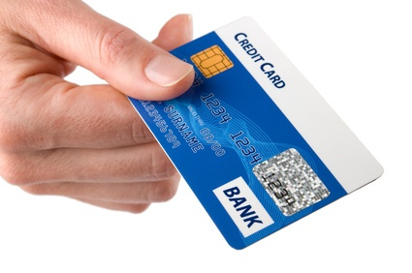
Notes:
The last five times you used your credit card THAT HAS YOUR NAME ON IT, how many times did the cashier use your name in giving it back to you?
FORWARD

Slide 198
Common Practice
Common Sense
It is better to be consistently good than occasionally great.
Notes:
All this is common sense.
CLICK FOR EFFECT
But is it common practice? Let me ask you. I’m telling you that 70 years ago Dale Carnegie said that the key to creating friends, to connecting with your customer, was to use the customer’s name. Make them feel important.
FORWARD

Slide 199
Knowledge is power.
Notes:
You’ve heard Knowledge is Power. And I’m here to tell you knowledge is NOT power. It is what you DO with what you know that is the true power. If you spent the money to attend these webinars but you do nothing with the notes you will take, then NOTHING WILL CHANGE. Except for the fact that you are a little poorer. That isn’t good enough for you. I am convinced you CAN commit to being the World’s Best. If you take REAL action NOW, you CAN BE THE DIFFERENCE.
FORWARD

Slide 200
Knowledge is power.
Notes:
You’ve heard Knowledge is Power. And I’m here to tell you knowledge is NOT power. It is what you DO with what you know that is the true power. If you spent the money to attend these webinars but you do nothing with the notes you will take, then NOTHING WILL CHANGE. Except for the fact that you are a little poorer. That isn’t good enough for you. I am convinced you CAN commit to being the World’s Best. If you take REAL action NOW, you CAN BE THE DIFFERENCE.
FORWARD

Slide 201
The
implementation
of knowledge
is power.
Notes:
You’ve heard Knowledge is Power. And I’m here to tell you knowledge is NOT power. It is what you DO with what you know that is the true power. If you spent the money to attend these webinars but you do nothing with the notes you will take, then NOTHING WILL CHANGE. Except for the fact that you are a little poorer. That isn’t good enough for you. I am convinced you CAN commit to being the World’s Best. If you take REAL action NOW, you CAN BE THE DIFFERENCE.
FORWARD

Slide 202
What can you CASE today.
Review and remove all the dissatisfiers from your Student Experience and replace with small “wows”.
Review and enhance your Employee Experience.
Read the Dale Carnegie sheet every day to Be the Difference.
Notes:
So what ARE SOME CASE IDEAS YOU CAN DO right after you turn off this webinar.
CLICK FOR EFFECT
Review and remove JUST ONE dissatisfier from your customer experience and replace with a small wow. And then do one more tomorrow.
CLICK FOR EFFECT
Review and enhance your Employee experience.
CLICK FOR EFFECT
Download the Dale Carnegie sheet, read it EVERY DAY and BE THE DIFFERENCE for your team and for your customers.
FORWARD

Slide 203
Learning about
customer service
has to be seen
not as an event
but rather as a process.

Slide 204
Challenge Yourself

Slide 205
What can you do this year?
  Create a Student Survey
  Create a Student as Customer Focused Orientation
  Create a Suggestion Hotline
  Create a CSI team
  Allocate marketing money to improve the student experience
  Create a Rewards system to recognize customer service performance or improvement

Slide 206
One person can make a difference and every person should try.
John F. Kennedy

Slide 207
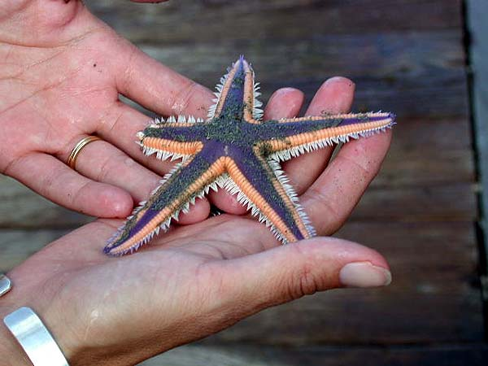
Notes:
But Bill, you don’t understand. I’m not the top dog. I don’t control the checkbook. I don’t have much say. I don’t think I can be the difference for my company. Let me end my presentation with this story.
A young boy was walking along a beach among thousands of starfish. When he came to a starfish, he would pick it up, and throw it back into the ocean.
He had been doing this for some time when an old man approached him and said, “Little boy, what are you doing? Little boy said, “There was a storm last night. It washed up all these starfish onto the beach. If they don’t get back in the ocean they will all die.”
The old man said Look at this beach! From my right foot as far as I can see, it’s littered with starfish and you’re just one little boy. Do you think you can make a difference?”
Little boy bent down, picked up a starfish, and hurled it as far as he could into the ocean. Then he looked up at the man and replied,
“Well, I made a difference to that one!” Two morals to that story.
HRE IS THE FIRST:How do you think that ONE starfish felt for WHAT THAT LITTLE BOY DID. Greeat!!
HERE IS THE SECOND: When you are standing in front of your customer, you have the ability to BE THE DIFFERENCE for them. Make them feel you truly ARE The World’s Best. But it is up to you. COMMIT TODAY TO BE THE BEST IN THE WORLD.
FORWARD

Slide 208
One expectation of any meeting:
We want the meeting
to change things.

Slide 209
People change things.
So when do we start?
NOW!

Slide 210
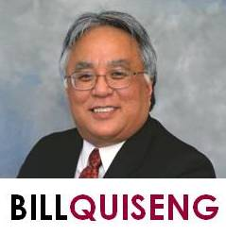
Thank You
Bill Quiseng
billq@billquiseng.com
231.881.0695
facebook.com/billquisengdotcom
Twitter @billquiseng

